Slide 1






Architecture diagram for Smart Maintenance System for Industrial IoT
Azure Subscription
Azure AI Foundry
Azure AI
Agent Service
Azure AI Search
Orchestration
Semantic Kernal
Semantic Kernel to plan repair workflows dynamically
Azure Blob
Storage
IOT Hub
Predictor
RAG/ Retriever
Alerting
Azure Monitor

Slide 2
Workflow diagram for Smart Maintenance System for Industrial IoT
The workflow diagram shows integrating Azure AI and devices.
Devices stream telemetry data into the system.
Azure AI Foundry acts as the orchestrator, delegating tasks to the Semantic Kernel, which dynamically plans workflows.
The Semantic Kernel coordinates three key agents: Predictor:
which forecasts equipment failures; the Retriever/RAG:
which fetches relevant maintenance documents from Blob Storage;
Alerting module,
which triggers notifications. Alerts connect to Azure Monitor, where anomalies are tracked and compliance dashboards are generated.
This design ensures the responsible AI-driven decision-making.
Azure AI Foundry
Semantic Kernal
Predictor
Devices
RAG/ Retriever
Alerting
Azure Monitor

Slide 3
Retriever Agent
Fetches latest telemetry from Azure AI Search.
Input: DeviceID or query.
Output: Structured telemetry
Predictor Agent
Runs failure prediction using telemetry.
Input: Output from Retriever Agent.
Output: Prediction.
Alerting Agent
Sends notifications if a threshold is exceeded.
Input: Output from Predictor Agent.
Output: Alert

Slide 4
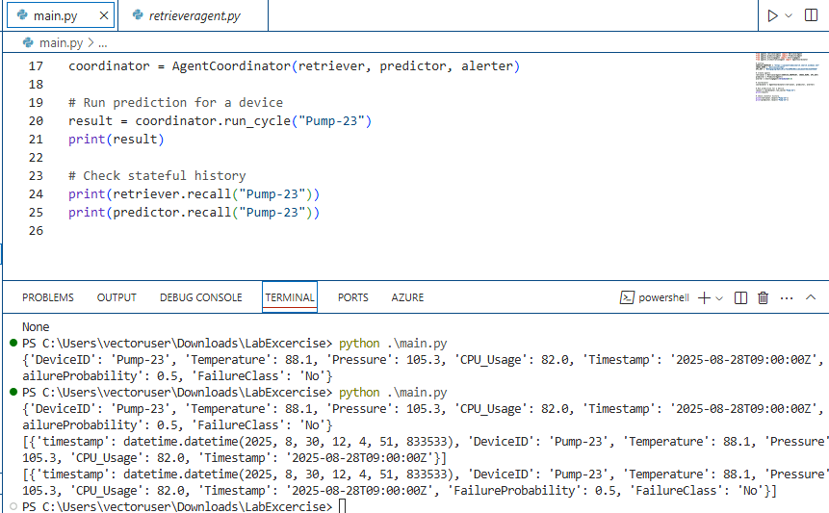
Screenshots – Actual run with stateful agents

